Slide 1
CNN for handwritten alphabets
14010994 Computer Engineering Yeongjoon Ju
14011870 Computer Engineering Kiwon Seo

Slide 2
CNN
Accuracy : 99.4%
Train : 279337 samples Validate : 93113 samples
Epochs : 18 Batch_size : 200 Optimizer : adam
Metric : accuracy

Slide 3
View Details

Slide 4
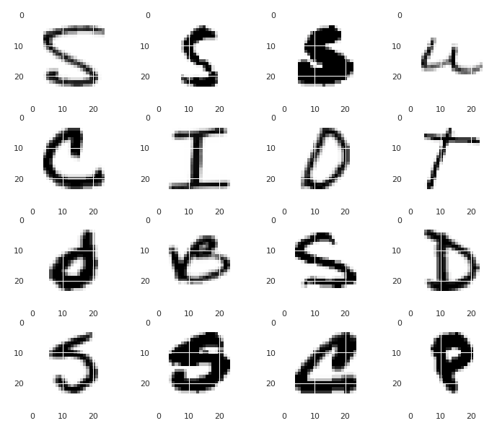
Load MNIST dataset

Slide 5
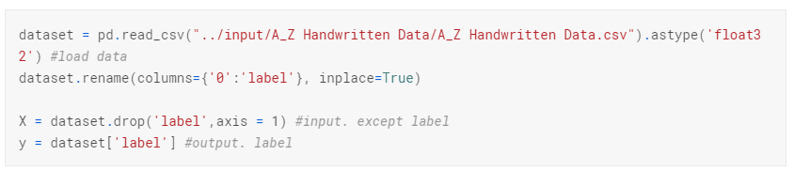
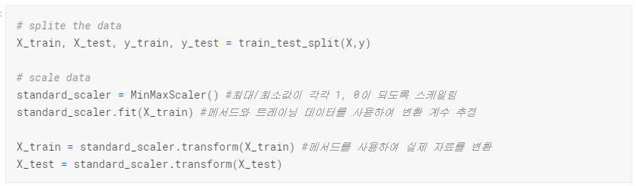
Load dataset
Load Data
Split data

Slide 6
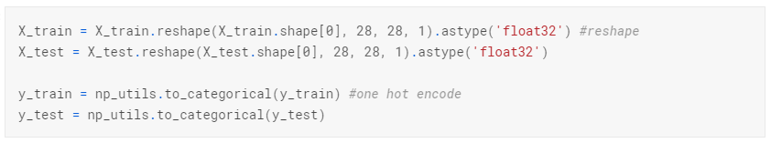
Load dataset
One-hot encoding

Slide 7
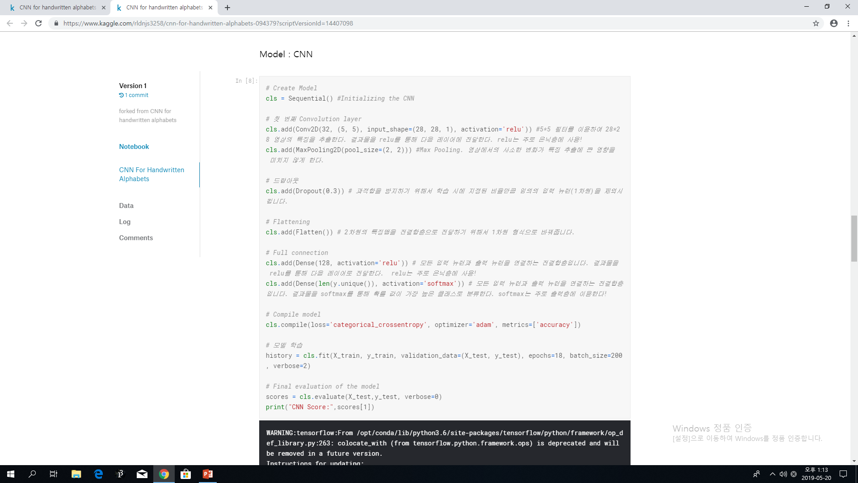
Create Model
CNN Model
Dropout
Flatten

Slide 8
Create Model
Full connection
Compile Model

Slide 9
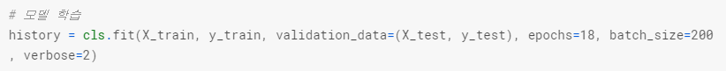
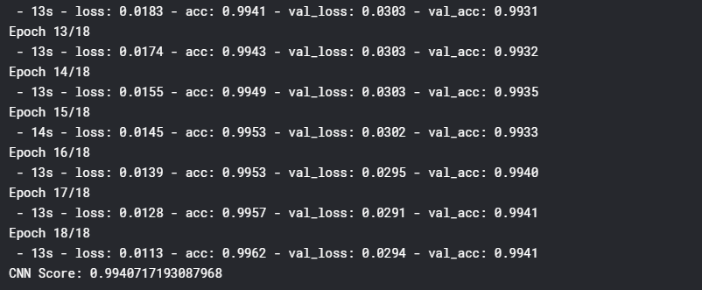
Train and Evaluate Model

Slide 10
Q&A

